Slide 1



GRC Gamers
Presented By: Joshua Kurth
SDEV101
Last Updated: 3/13/2024

Slide 2
Dataset: Video Games
Source (original file):
https://corgis-edu.github.io/corgis/csv/video_games/
Background:
Joe Cox, University of Portsmouth, May 21, 2015
Data used in study “What makes a blockbuster video game?”
Data includes 1,000+ games from 2004-2008 including Title, Sales in Millions, Review Score, ESRB Rating, & playtime length data.

Slide 3
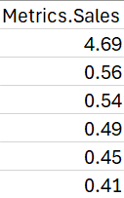
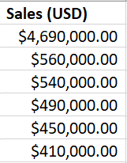
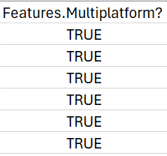
Data cleaning
Data Conversions
Missing/Irrelevant Data
Converted Sales data into USD
Split text in columns containing multiple data points (i.e. publishers & genres)
Removed categories that contained “True” or “False” as all games showed “True” in each column.
Removed Playtime Data

Slide 4

Focus data
Title, Genre, Publisher, Review Score, Sales (USD), ESRB Rating, Console, & Release Year
Main Focus: Sales & Review Scores

Slide 5
Questions
What were the Top 10 games with over $1 Million in Sales?
What was the average review score for the top 10 best selling games?
What were the total sales by Console each year from 2004-2008?
What are the average review scores by console from 2004-2008?
Is there a correlation between sales & review scores?

Slide 6
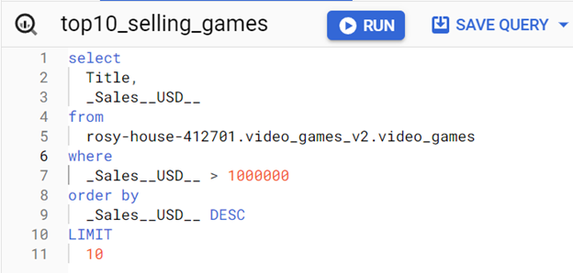
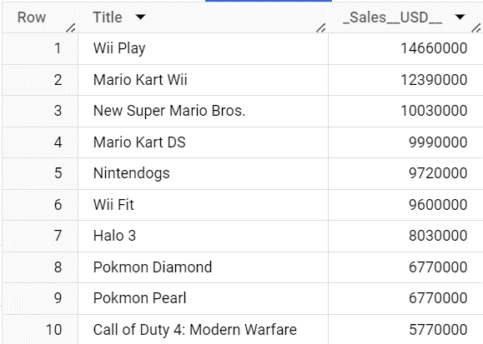
What were the Top 10 games with over $1 Million in Sales?
BigQuery
8/10 published by Nintendo
Halo 3 is the only XBOX exclusive

Slide 7
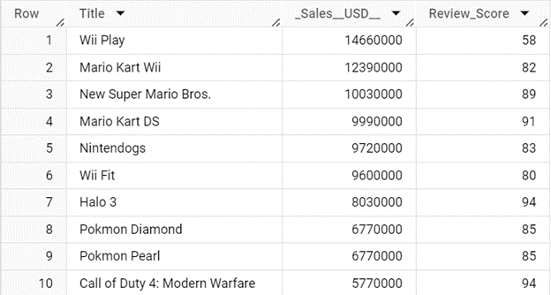
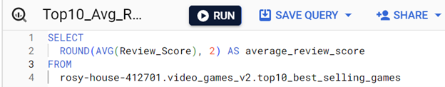
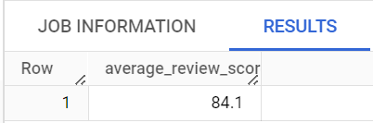
What was the average review score for the top 10 best selling games?
BigQuery
Removing Wii Play, raised AVG to 87
Games with higher sales tend to have better reviews

Slide 8
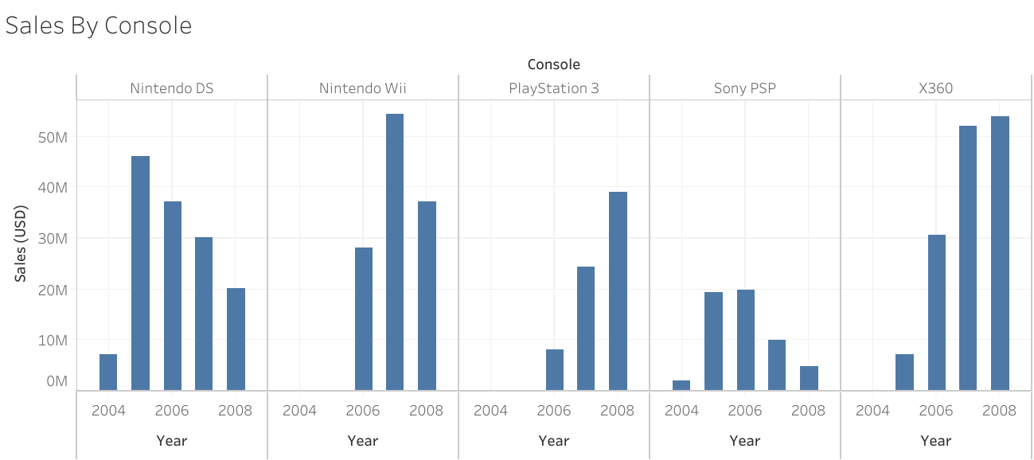
What were the sales by Console each year from 2004-2008?

Slide 9
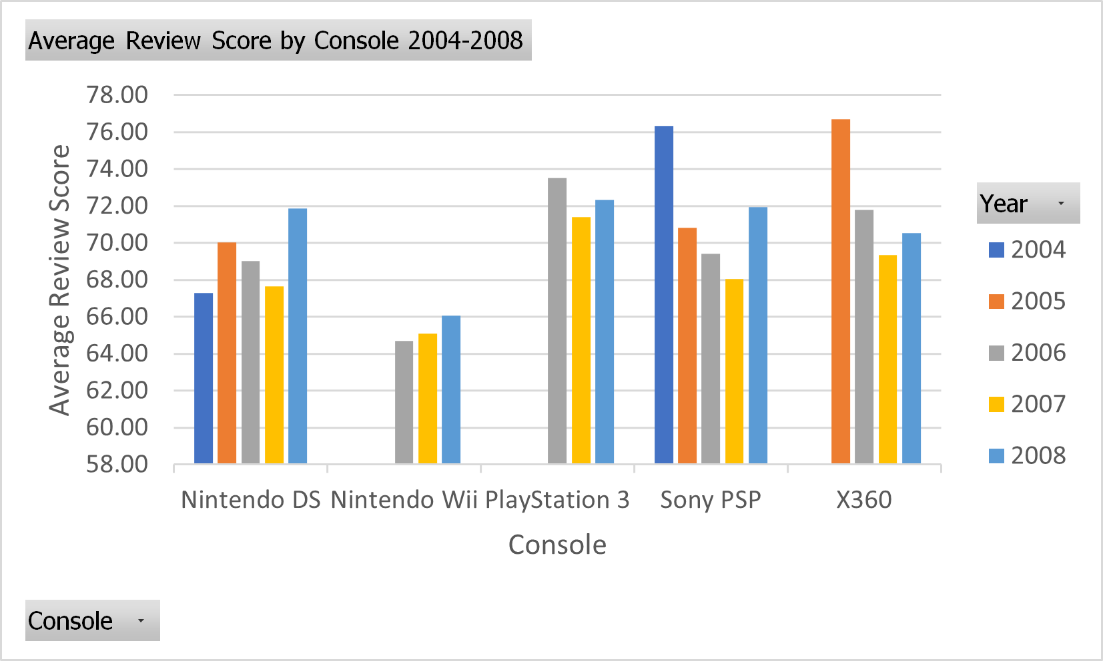
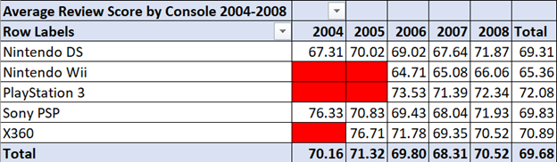
What are the average review scores by console from 2004-2008?
Tableau & Excel
2008 had the best review results for all 5 consoles.
Handheld devices (DS & PSP) started high, but lost traction as consoles evolved.

Slide 10
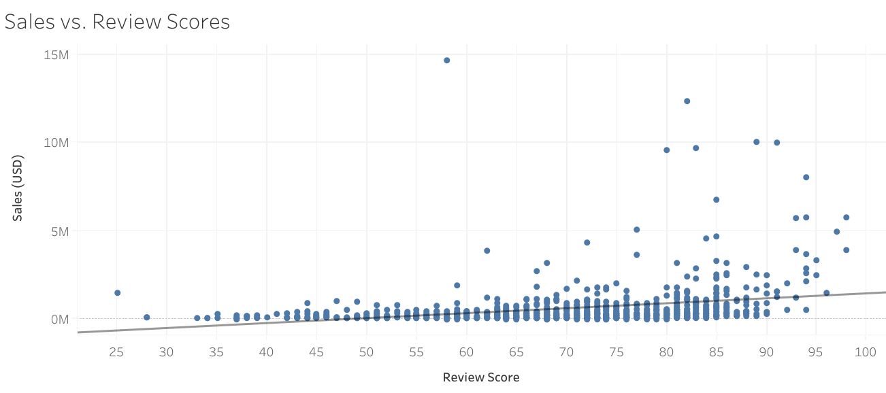
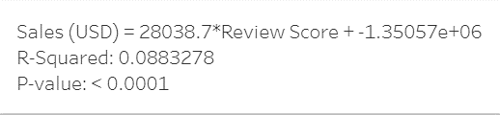
Is there a correlation between sales & review scores?
Outlier: Wii Play
Sales: $14,660,000
Review: 58

Slide 11
conclusion
Video games with higher sales, have higher review scores.
Challenges:
Data Cleaning
SQL Join Queries
Additional Questions:
How do video game sales from 2009-Now look?
Do sales and review scores of games between 2009-Now still show a correlation?

